Slide 1
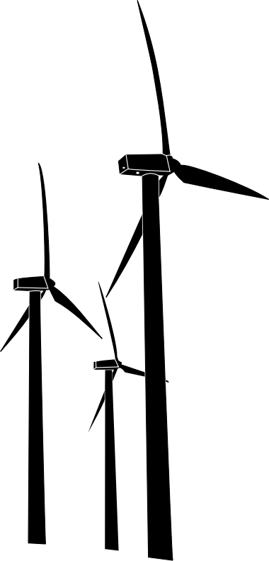
Power System Analysis in an Induction Wind Turbine
Ben Z. David C. Tate S.
Matthew M. Melissa F.

Slide 2
About the Team
Ben Zickefoose – Team Lead
Melissa Flood – Power Engineer/Chief Engineer
Tate Stottmann - Power Engineer/Test Engineer
Matt Miner – Power and Controls Engineer/Meeting Scribe
David Clark – Controls and Embedded Engineer/Report Manager

Slide 3
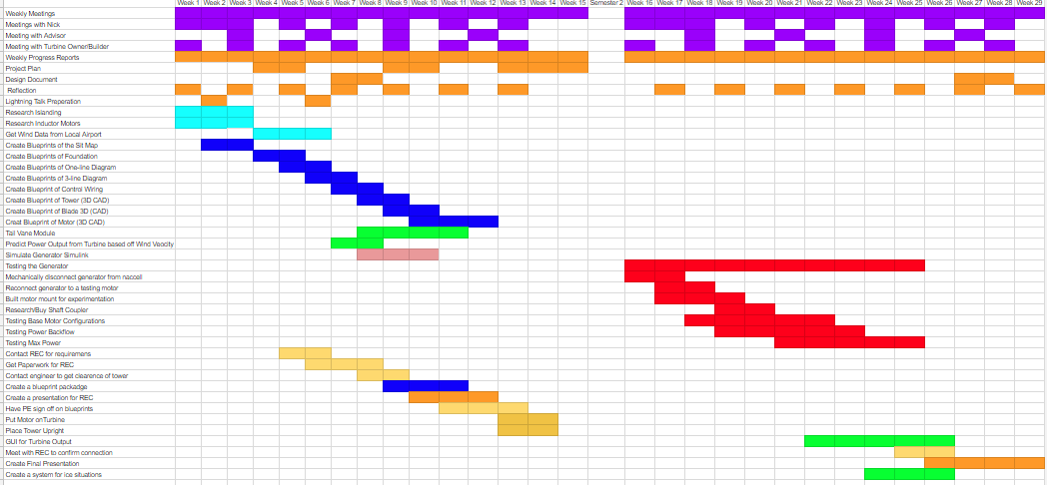
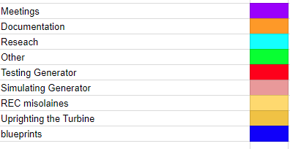
About the Team

Slide 4
Problem Statement
Power Generation through a wind turbine.
Ron Zickefoose (client)
Power Utilities requires proof of being safe and not hazardous to the grid or the public.

Slide 5
Goal
The biggest hurdle to us is getting approval from the utility to turn on the turbine
Our largest overall goal is to make our case to the governing utility (REC)
The vast majority of wind turbines in operation that utility deal with are synchronous type turbines; our’s is an induction type turbine
An induction type turbine requires input power from the grid to operate at all and therefore should not be a hazard
Now we have to prove it

Slide 6
History of Project & Similar Products
This wind turbine has currently been under construction for 9 years now.
The construction has taken so long because it’s basically being built by one man, and in order to better budget out the cost of parts.
It is based off of the design by Bob Zickefoose, who has a nearly identical tower on his property in Virginia.

Slide 7
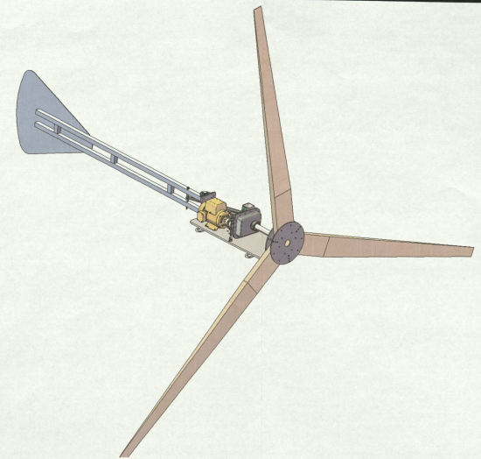
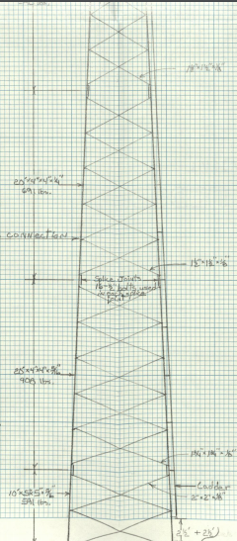
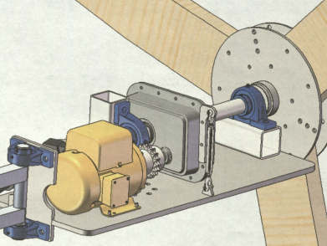
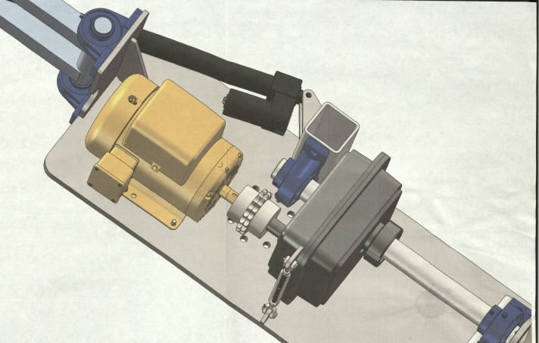
Structure and Layout
120 ft. tall tower
3 - 10 ft. fixed blades
4 kW expected output
Induction type Generator (motor)
230Volts
60 Hz
1800 Rpm to generate

Slide 8
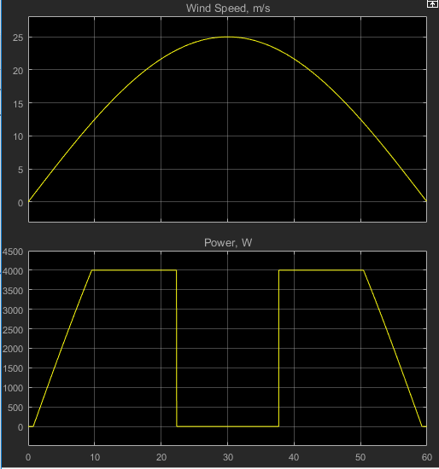
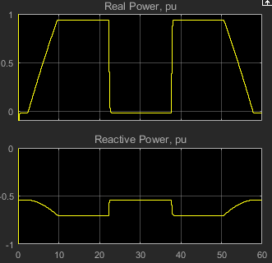
Asynchronous Generator
The motor takes Reactive power to charge the core.
Real power will be created when the rotor Spins faster than the synchronous speed (1800 rpm).
The controller will be used to find the optimal time to be powered up

Slide 9
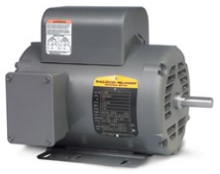
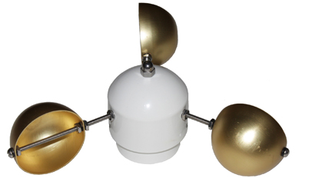
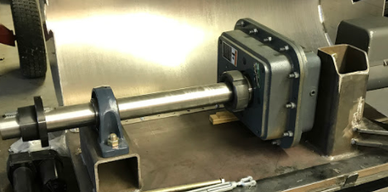
Parts
Gear Box
Ratio 1:14.454
Generator
BALDOR motor L1430T
5 hp, 1ph
230Volts
60 Hz
1800 Rpm to generate
Anemometer
Accuracy 11 mph to 55 mph
Reed switch

Slide 10
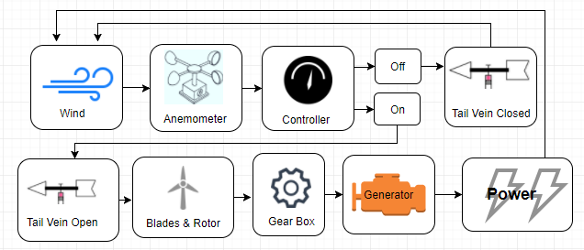
System Flow Design

Slide 11
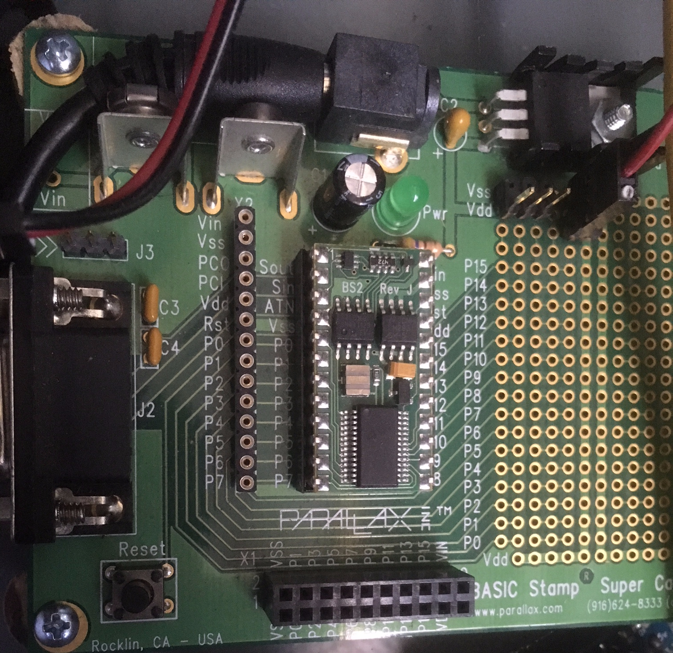
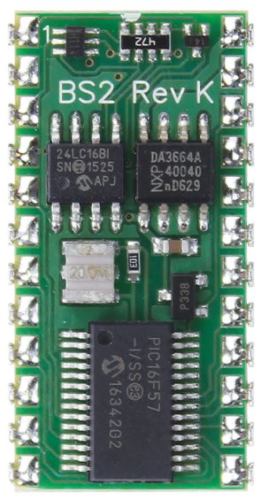
Microcontroller
Parallax Module:
Basic Stamp 2 Microcontroller
Super Carrier Board
Notes:
Basic Stamp - $49, Carrier Board - $28.99

Slide 12
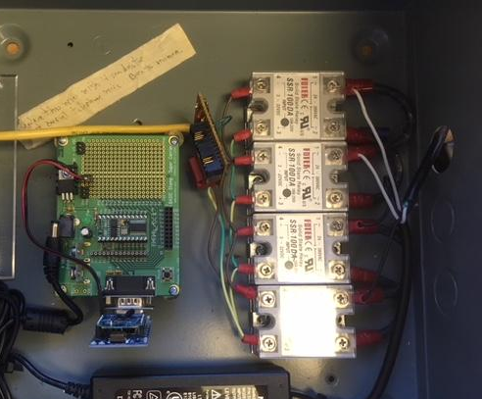
Microcontroller
The system gets a signal from the anemometer.
Microcontroller sends a signal to the relays.
Dependent on wind speed.
PBasic programming language.
Relays open allowing the grid power to connect to the induction motor and the tailboom.

Slide 13
Tail Vane
Tail Vane operation is critical for successful turbine use.
Designed to stop and start rotor.
Protects from high wind speeds.
Ensures rotation in safe environment.
Battery Backup.
Notes:
Tail Vane Operation
Rotor Stop/Start
High Wind Speeds
Safe Environment
Battery

Slide 14
Circuit and Operation - Tail Vane
Pins 1-2: Vane Open Switch
Pins 3-4: Vane Close Switch
Pin 5: Motor Open
Pin 6: Motor Close
1-2 | 3-4 | 5 | 6
0 | 0 | V | V
0 | 1 | 1 | 0
1 | 0 | 0 | 1
1 | 1 | NA | NA

Slide 15
Tail Vane Conclusion
Critical module.
Facilitates optimum operation.
Reliable relay system.
Controller signals.
Extra safety with battery backup.
Notes:
Module
Optimum Operation
Relay
Controller
Battery backup.

Slide 16
Working With Others
Collaborate with:
Rural Electrical Company (REC) ℅ Rick Whalen; Hampton, IA
REC’s Consultant: Stanley Consultant ℅ Brian Schoer; Muscatine, IA
UL Certified Individual: under investigation
Local Electrical Inspector (NEC)
Ron Zickefoose
Bob Zickefoose
James McCalley/Nick David
Our Team

Slide 17
Working with Others
Collaborate with the Rural Electric Company (REC) to achieve:
Interconnecting on the grid
Initializing the induction motor
Ensure safety during all modes of operation (or lack thereof)
Supply any surplus of energy back onto the grid

Slide 18
Summary of REC’s Solar Electric Tariff
Our Turbine is a ‘Level 1’ System
Capacity of 10kVA or less
Does not exceed 15% of maximum load on the radial distribution circuit
Generation capacity on a secondary line won’t exceed 20 kVA
Will not create an imbalance of 240 volts of 20% of nameplate rating
REC will not need to upgrade any component of their facilities
Protective equipment will keep imported power from the utility to the network to stay above 1% of the networks maximum load.

Slide 19
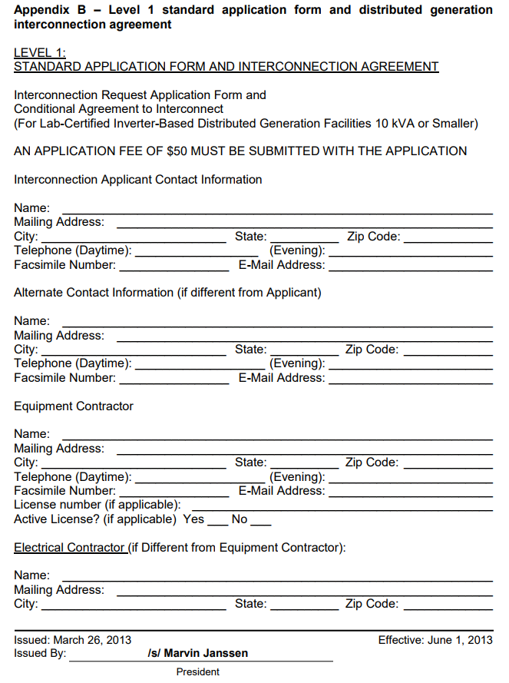
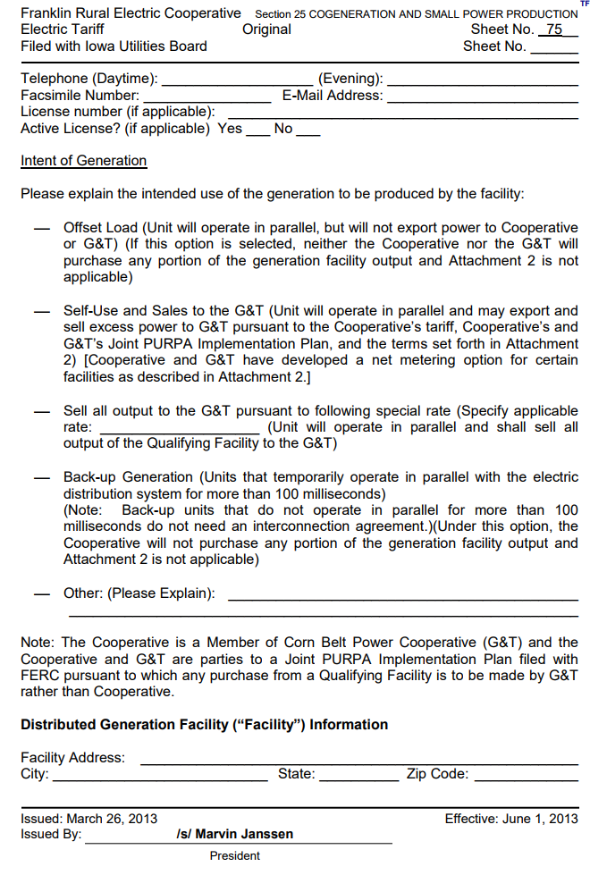
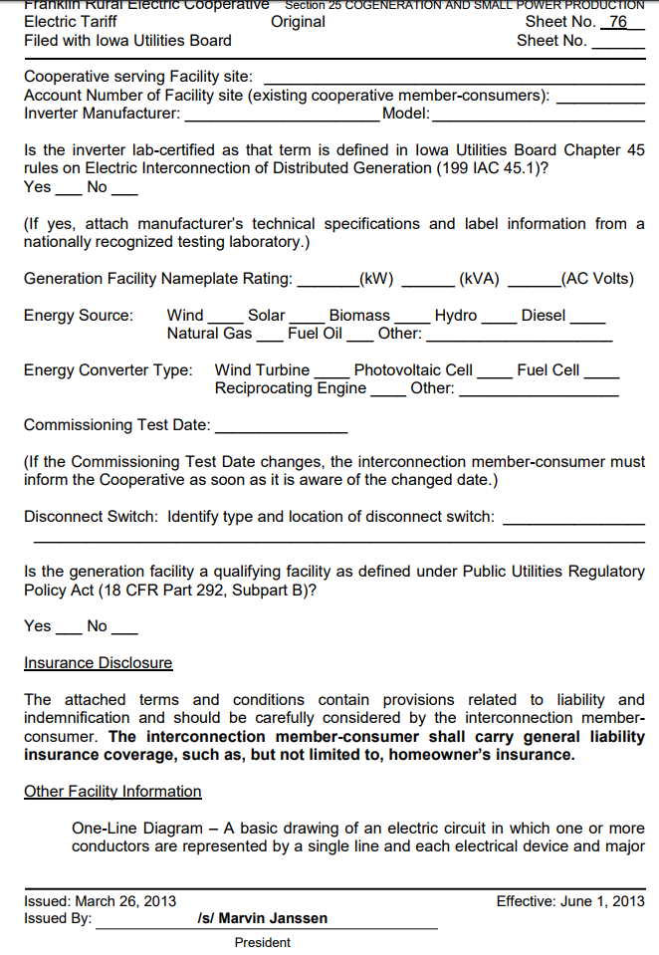
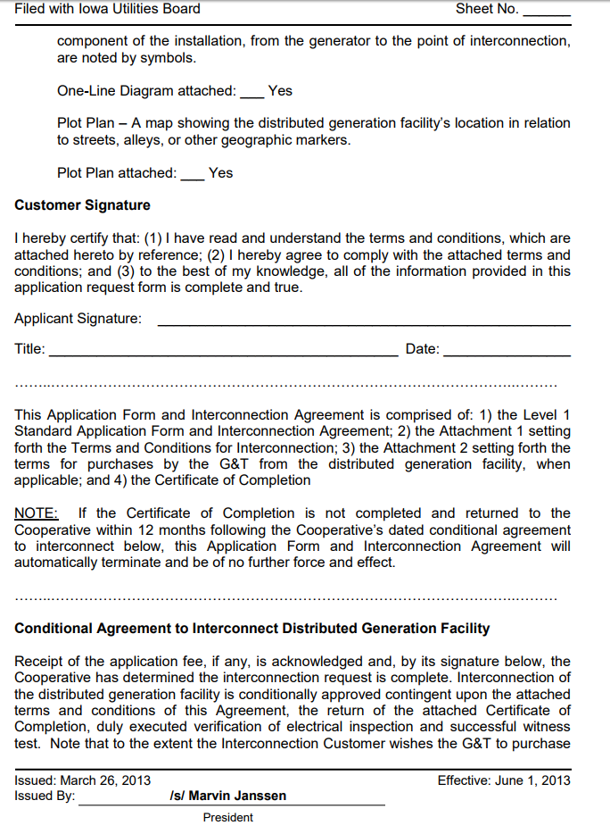
Summary of REC’s Solar Electric Tariff
Submitting an Application form
$50 application fee
General Contact Information
Intent of Generation
Self-Use and Sales to the G&T
Nameplate ratings and Type of Generator in use
Verifying various policies are being followed
Public Utilities Regulatory Policy Act
Lab-certified Inverter
Attachments of One-line Diagrams and Plot Plans

Slide 20
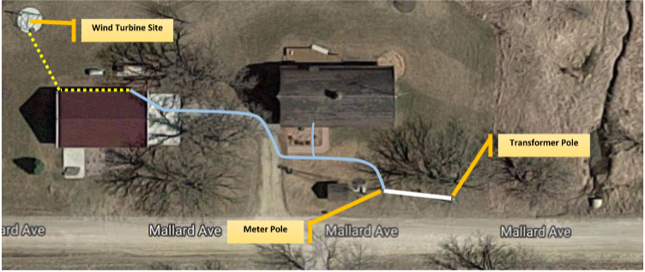
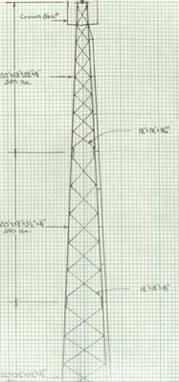
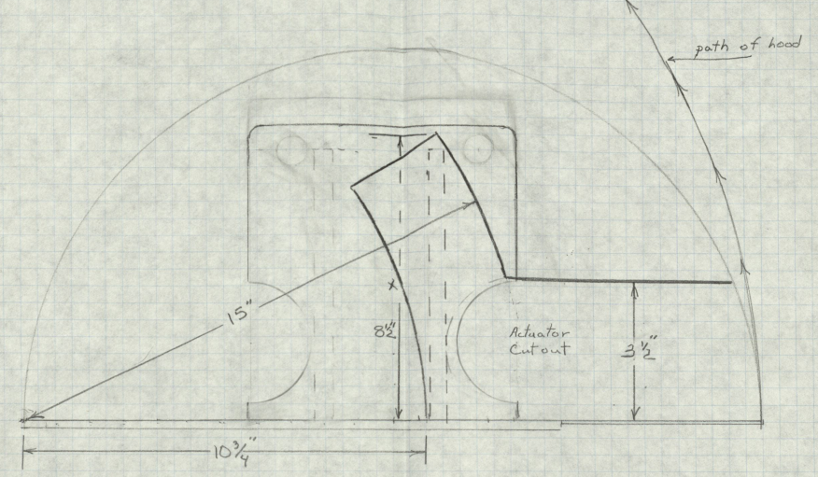
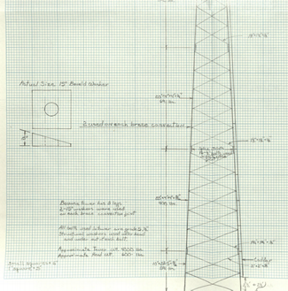
Plot Plan
One Line Diagrams

Slide 21
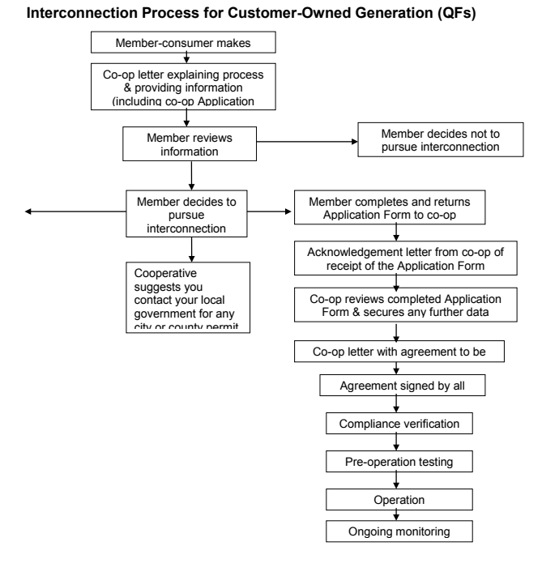
Summary of REC’s Solar Electric Tariff
Standard Interconnection Agreement
Local electrical inspection to meet local code requirements
Certificate of Completion
Disconnect switch at the metering equipment
Utility has the right to disconnect the generator for various reasons
Homeowners insurance

Slide 22
Testing the Generator
Purpose: The current generator is not UL certified which is nationally recognized Standards for Safety.
Types of tests: For Alliant
Anti-Islanding Test
Non-Export Test
In-Rush Current Test
Surge Withstand Capability Test
Synchronization Test

Slide 23
Conclusion

Slide 24
Questions?

Slide 25
Appendix (Extra Slides)

Slide 26
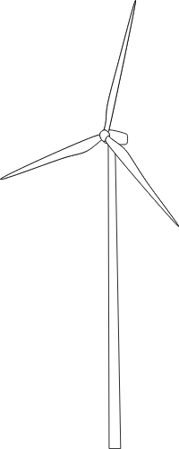
Anti-Islanding Test
Pertains to the safety of lineman if the power grid was to have an outage
UL 1741 Sec 46.3 Summary
Connect the single phase induction motor to a SUS and a balanced load circuit.
A quality factor(Q) of 2.5 or less should occur determined by:
R: Resistance
C: Capacitance
L: Inductance
P_{ql}: Reactive Power consumed by the inductive load
P_{qc}: Reactive power consumed by the capacitive load
P: Real Power
Q: Quality Factor

Slide 27
Anti-Islanding Test
UL 1741 Sec 46.3 Summary Cont.
Reactive frequency(f) needs to match the frequency of the inverter determined by:
F: resonant frequency
L: Inductance
C: Capacitance
Energize SUS, close Switch 3 and open Switch 2 to disconnect the inverter.
The P_{ql} should be 2.5 times the amount of the real output power of the inverter shown designated in a table not shown.
Inductance and capacitance are found using

Slide 28
Anti-Islanding Test
UL 1741 Sec 46.3 Summary Cont.
Adjust capacitive reactive load to match the inductive reactive power within +1% of real power.
Close switch 1 and 2 after reactive loads are set.
Either the output power of the inverter or the resistive load should be adjusted to minimize current at switch 3
If test passes: The inverter stops exporting power to load within 2 seconds of switch 3 being open. This occurs when the reactive load is +5% of initial load.

Slide 29
Non-Export Test
Reverse the power or lower the power of the induction generator.

Slide 30
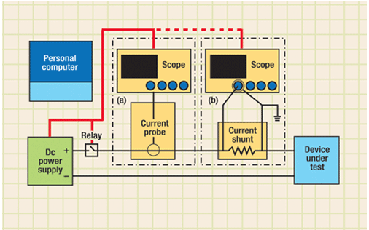
In-Rush Current Test
Used to estimate Starting Voltage Drop
Determines the maximum current drawn in starting the induction generator that is used from the utility company.

Slide 31
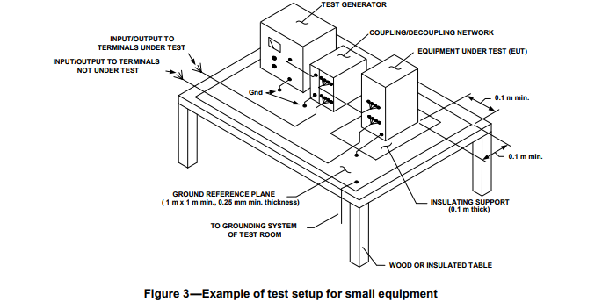
Surge Withstand Capability Test
Confirms that surge withstand capability is met and equipment will not fail
IEEE Standard C37 for SWC tests Summary
Short the high voltage input of the voltage divider to the ground.
The induction generator shouldn’t deviate from a straight horizontal line more than 1% of original output.

Slide 32
Synchronization Test
Demonstrates that when the induction generator closes that all parameters stay within limits. Parameters include voltage difference, frequency difference, phase outside of synchronization.
IEEE Std 1547 for Interconnecting with Distributed Resources Summary
Once all parameters are in range the paralleling device does not close.
Visual inspections are done on the grounding coordination and induction generator has an isolation device.

Slide 33
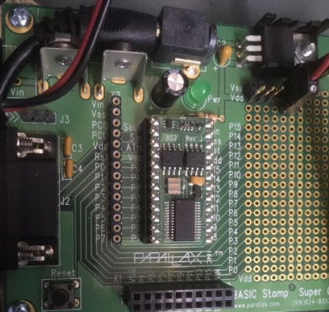
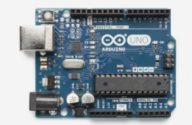
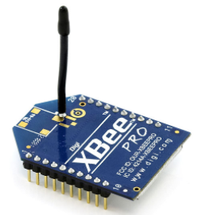
Different Model of Controller
Original - Microchip:PIC16F57
Uses P-basic
Unfamiliar
Substitute - Arduino UNO
C based
Strong web based resource
Commonly used
Same
X-BEE pro

Slide 34
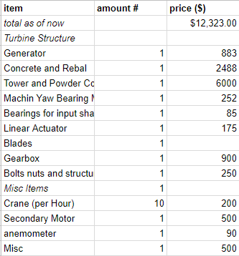
Budget
Items listed are already purchased and bought from the project client.

